Slide 1
Materials Manufacturing (EDPT 601)
Tutorial 3 ( Metal Forming Processes)
Sheet metal forming
By: Eng. Sherifa Taher

Slide 2
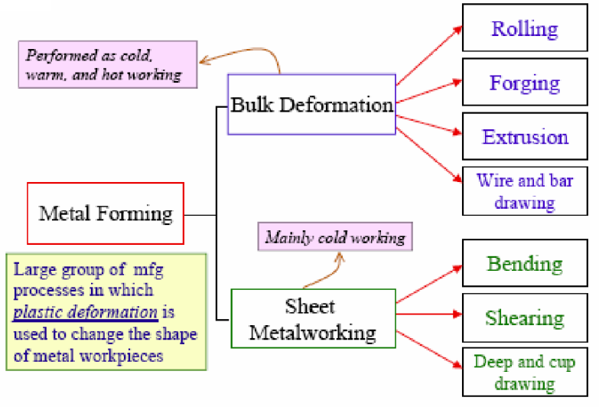
Classification of metal forming processes

Slide 3
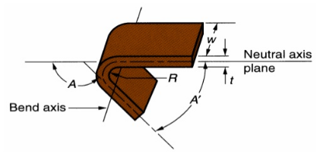
Sheet metal forming processes
Bending
It is the process of deforming or straining of a sheet metal around a straight or linear axis to take a permanent bend.
The sheet metal is subjected to compression (on inside of neutral plane) as well as tension (on outside of neutral plane)

Slide 4
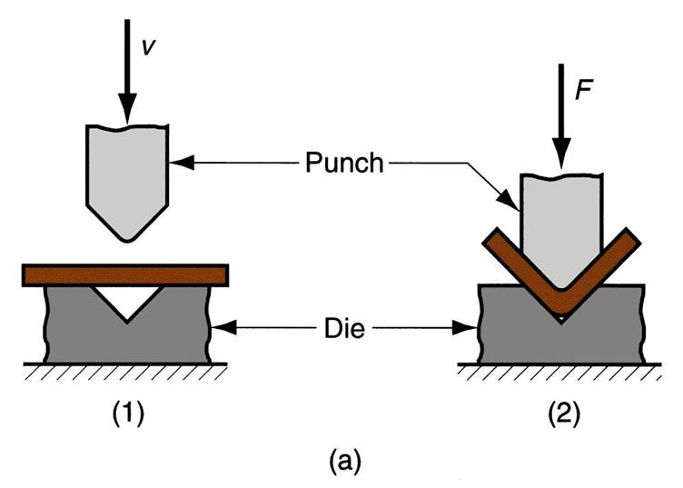
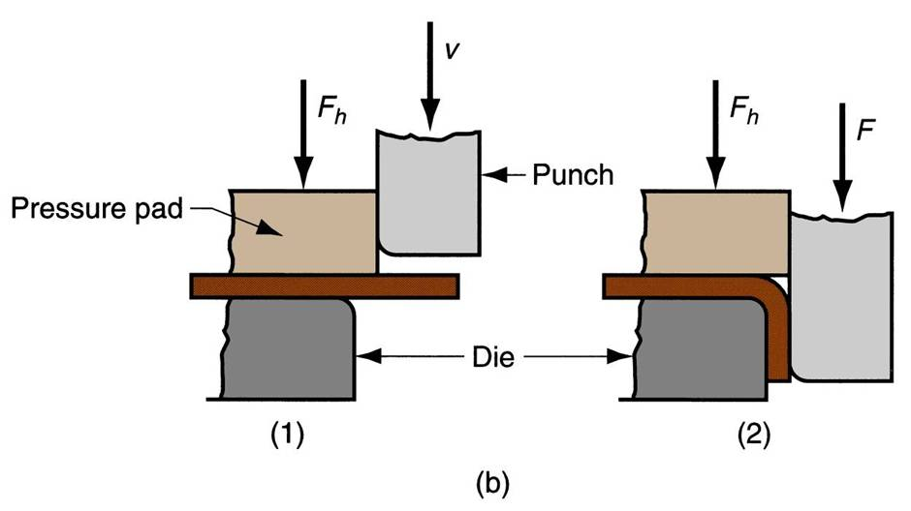
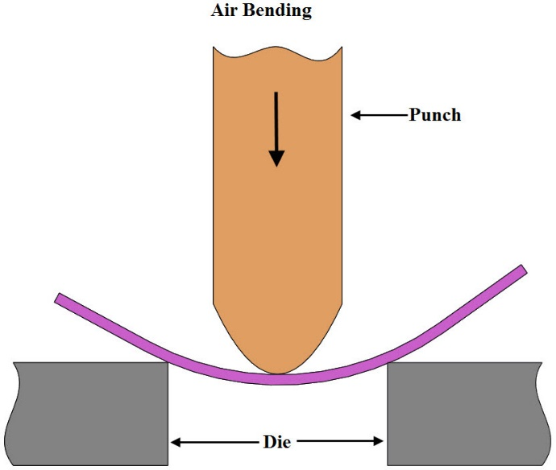
Types of bending
1. V-bending | 2. Edge bending | 3. Air bending
For low production Simple and inexpensive | For high production Dies are more complicated and costly Requires pressure pad | Flexible and requires relatively low forces Less precise than other bending operations.

Slide 5
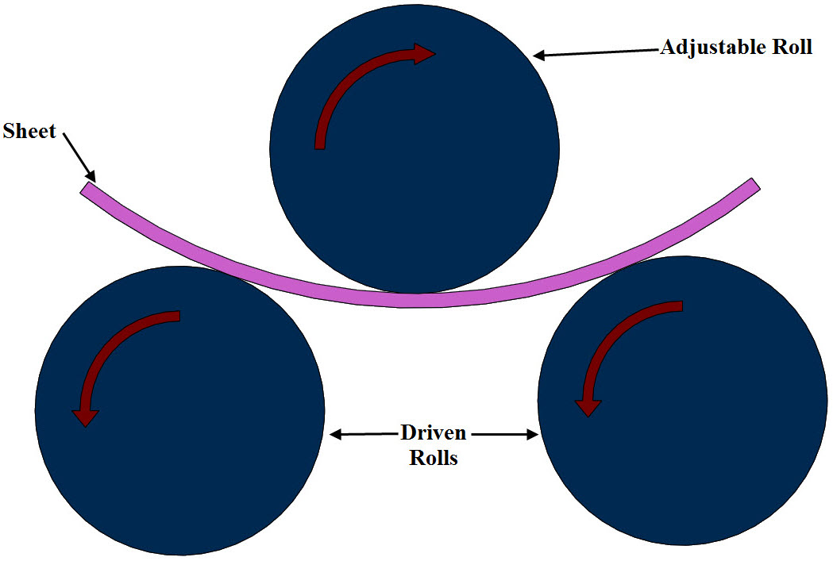
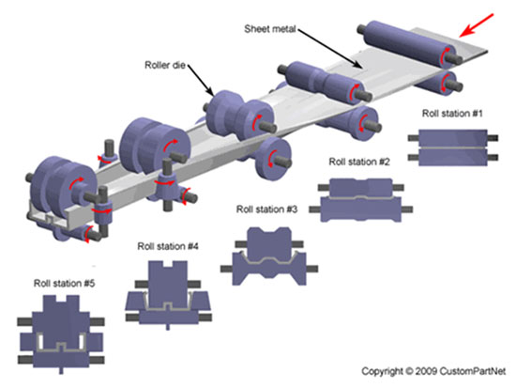
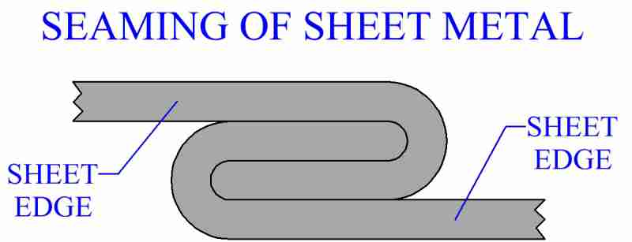
Types of bending
4. Roll bending | 5.Roll forming | 6. Seaming
Continuous process For sheets, pipes, plates and beams. | Transforms flat sheets into complex sections through progressive bending operations. | Commonly used in food industry on canned foods and used in automotive industry.

Slide 6
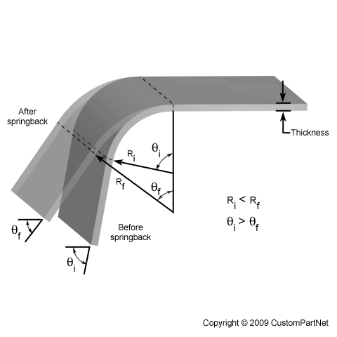
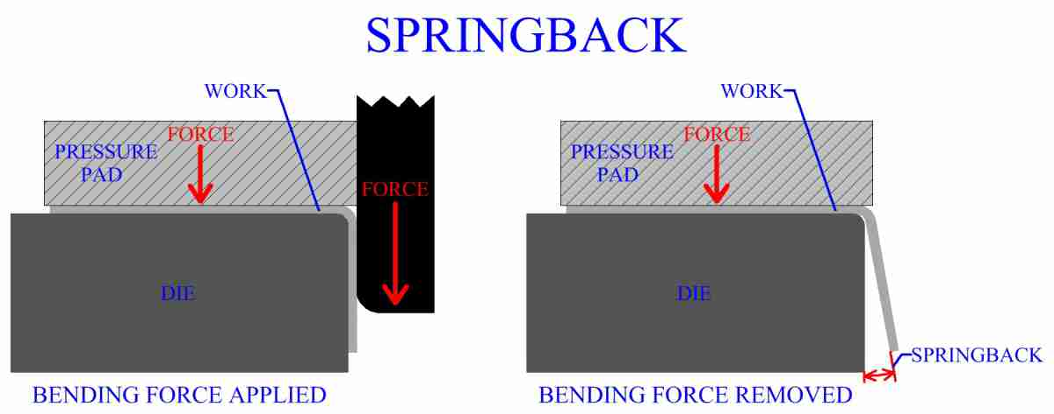
Spring-back
also known as elastic recovery, is the result of metal tending to return to its original shape after undergoing compression and tension (stretching).
Reasons: when bending pressure is removed, elastic energy remains in bent part, causing it to recover partially towards its original shape.

Slide 7
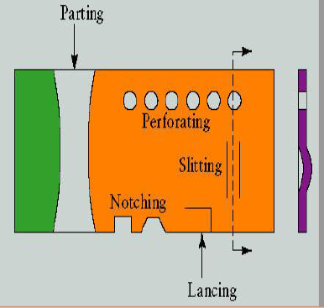
2. Shearing
There are several operations performed based on shearing:
Piercing (punching)
Blanking
Perforating
Parting
Notching
Lancing
Slitting
Nibbling

Slide 8
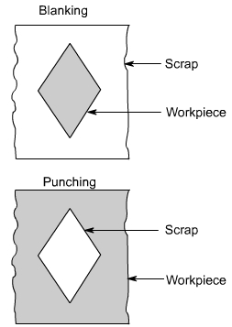
Piercing and blanking
Blanking: Sheared slug (part) is the required
part and the rest of the sheet is discarded as scrap
Piercing (Punching): Sheared slug (part) is
discarded as scrap.

Slide 9
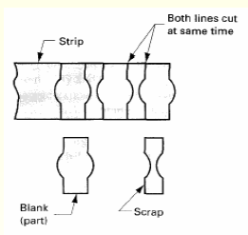
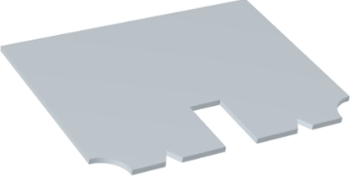
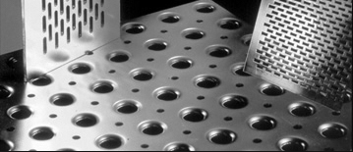
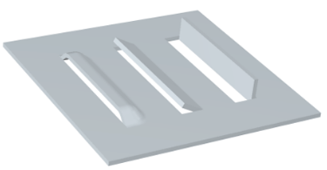
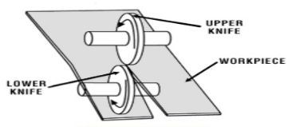
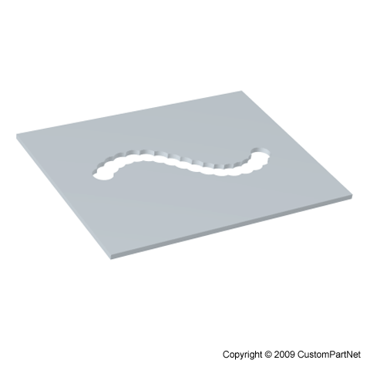
Perforating Punching a number of holes in a sheet. | Parting Shearing the sheet into two or more pieces. | Notching Removing pieces from the edges.
Lancing Portion of a hole is cut while the remaining is bent to a desired shape. | Slitting Shearing operation using circular blades that follow straight or circular paths. | Nibbling Shearing process that utilizes series of overlapping cuts to make complex shapes.

Slide 10
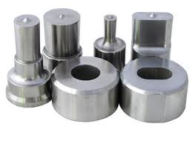
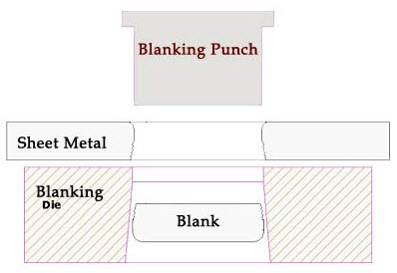
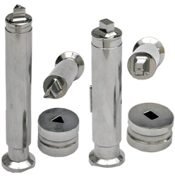
Punching dies

Slide 11
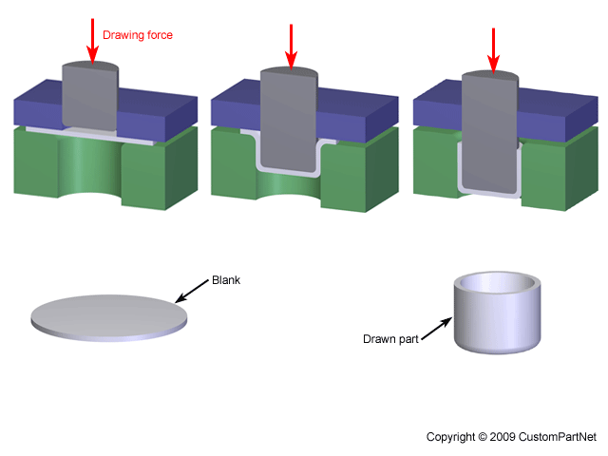
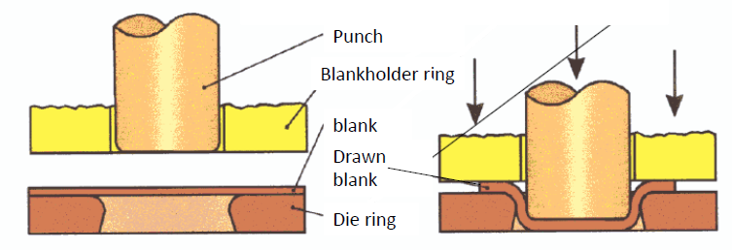
3. Deep drawing
A flat blank is formed into a cup by forcing a punch against the center portion of a blank that rests on a die ring.

Slide 12
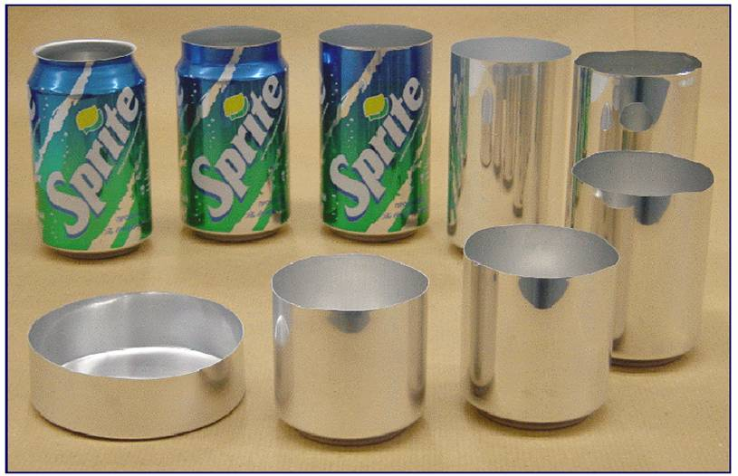
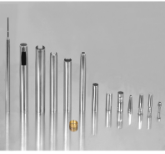
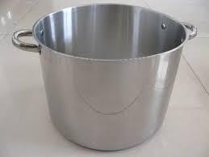
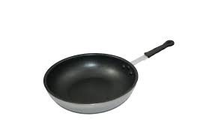
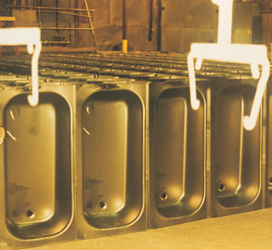
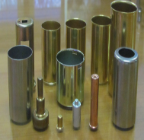
Deep drawn products

Slide 13
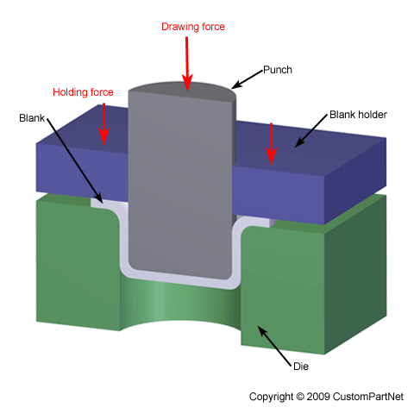
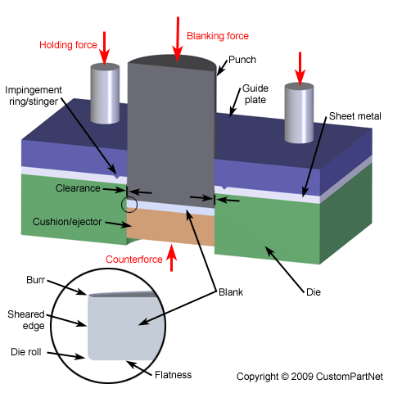
Shearing and deep drawing dies
Clearance between punch and die is greater than material thickness

Slide 14

Deep drawing defects
Flange wrinkling: small holding force.
Wall wrinkling: insufficient holding force, wrinkling initially occurring on the flange.
Tearing: high stress and sharp die corners.
Earing: anisotropy of the material.
Surface scratches: Die or punch not having a smooth surface, insufficient lubrication.

